Slide 1


Home Coming !!

Slide 2


Our Application Story!!
A Portal for Apartment Agent , Apartment Owner , New Apartment Customer.
Customer can search for any apartment.
Select any apartment according to its condition (Temperature , Humidity , Light ).
In Urgent condition Agent or Owner can take care of their Apartment.

Slide 3

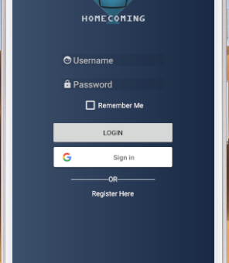
When User Logs in

Slide 4
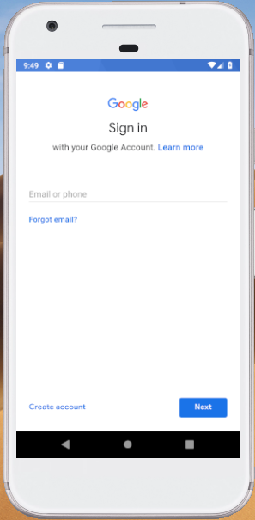
Google Sign In Authentication

Slide 5
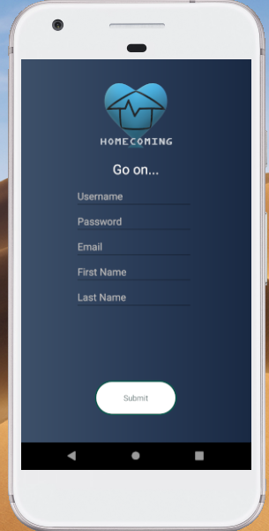
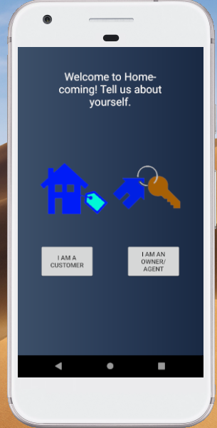
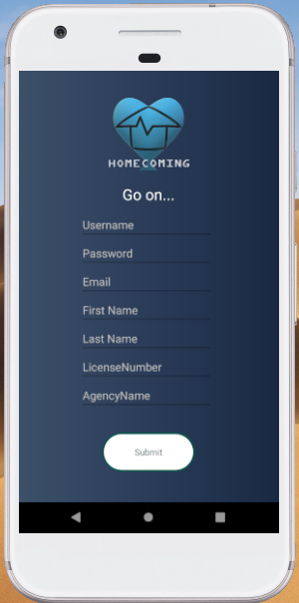
Registration page for Agent and Customer

Slide 6
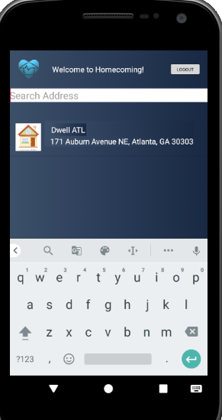
Customer searchs for apartments and gets the apartment list

Slide 7
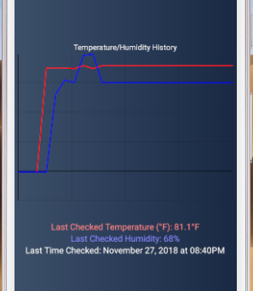
House Condition in Graph

Slide 8
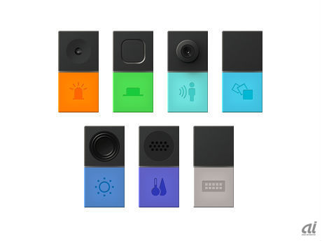
Sensor Used:
Humidity
Temperature.
Condition Evaluation
Extreme Condition shows in Red.
Normal Condition Shows in Blue.

Slide 9

How the sensors are used for Home Coming?
Our sensors , placed in the apartments have report, that humidity has dropped below regulated levels.
Our sensors , placed in the apartments have report, that Temperature has increased above regulated levels.
Our sensors , placed in the apartments have report, that Water level has increased above regulated levels.
Sensors Continuously monitor and send the data to the server.

Slide 10

Changes going to be added in future
More sensors to be added to get the condition perfectly.
Customer and owners can review the apartments and provide their feedbacks.
Customers and Owners can call or mail the agent through this application in urgent condition .

Slide 11
Thank You

